Slide 1

NACO Administration
Module 8
Module 8. NACO Administration
1
Notes:
(Date of slide or last update given at the top of the notes for each slide)

Slide 2
Questions?
Questions now?
Questions after today?
  Check documentation and training materials before asking for help
  Discuss with other catalogers
  If about training materials, contact trainer
  If about NARs, contact naco@loc.gov or reviewer
Notes:
Updated December 18, 2019: in notes changed Coop team to PTCP staff
Questions about issues brought up during training. Questions after today: contact appropriate people: trainers, reviewers, liaison, or staff within the LC Policy, Training, and Cooperative Programs Division (PTCP).
Who is the right person for NAR contact after independence? Preferably to naco@loc.gov , but to former reviewer is fine too.

Slide 3
Guidelines :
Information Provided
NACO training is administered by PCC, provided by Policy, Training, and Cooperative Programs Division at LC
  Program support, documentation, training materials, communications, advice
NACO authorizations provided by OCLC and SkyRiver
Notes:
Updated December 18, 2019: revised first bullet to reflect organizational changes at LC; updated notes
PCC provides: training, documentation, advice.
Advice and expertise within PTCP is available to everyone, but do try to work with your NACO liaison first. (PTCP is very busy.)
NACO authorization comes from utilities.

Slide 4
Guidelines :
Review Period
Independence must be achieved before direct contribution to OCLC and SkyRiver
Reviewer will be assigned locally or regionally; otherwise, LC will review
Review period is flexible, based on number of records
Notes:
May 1, 2013
Review is informal arrangement between reviewer and reviewee. Contributor must show progress before independence is established. After independence, the contributor can send records direct to authority file.
A general time period is six months to a year. However, if you produce a limited number of records, it could take much longer.

Slide 5
Guidelines :
Connexion Review Procedures
Create NAR and submit to review file
Notify reviewer by email (be sure to include OCLC code of library)
Ask brief questions or cite rules in 952 (OCLC)—otherwise, use email
Notes:
Updated December 18, 2019: slight revision to notes
Create NAR & send to review file; should be group of approximately 10 records based on your workflow. Email your reviewer; cite rules and brief questions in 952.
Remember that a local authority record does NOT have to be submitted for review; only the records that you are submitting to the national authority file must be reviewed.
(Can mention SkyRiver if/when information becomes available.)

Slide 6
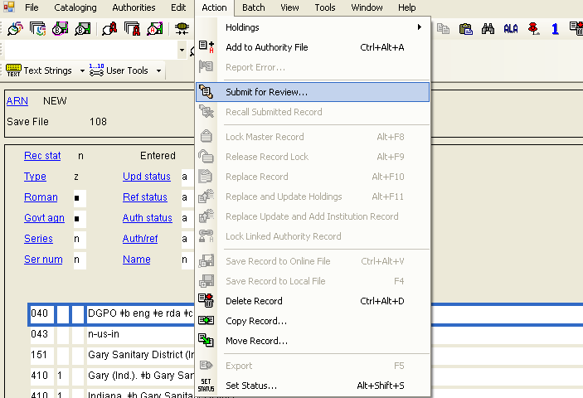
Connexion Review Procedures :
Submit for Review: click on Action, Submit for Review
Notes:
May 1, 2013
To have a record reviewed by another institution, click on Action, Submit for Review.

Slide 7
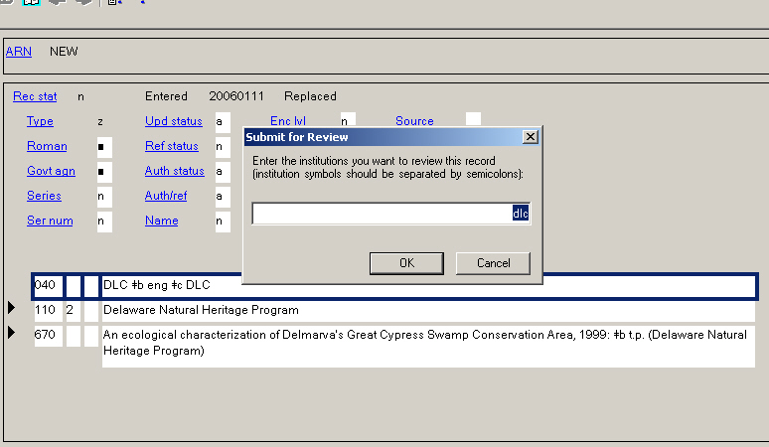
Connexion Review Procedures :
Submit for Review: fill in the OCLC symbol of the reviewer
Notes:
May 1, 2013
To have a record reviewed by another institution, after clicking on Action, Submit for Review, fill in the OCLC symbols for the institution or institutions you wish to see your record. The record remains in your local save file, but the other institutions have permission to see it.
(Will add screen shot for SkyRiver when information becomes available.)

Slide 8
Guidelines :
Connexion Authority Help
RDA NACO Reviewers Handbook for OCLC Connexion (July 2012)
http://www.loc.gov/aba/pcc/sct/documents/ PCCSCTNACO%20Reviewers%20Handbook_20120706_Final.pdf
OCLC documentation (last updated: May 2021)
https://www.oclc.org/resources/support/connexion/documentation/ browser/authorities/create_auth_records/create_auth_records_pdf.pdf
PCC documentation for review (browser and client use similar concepts)
http://www.loc.gov/aba/pcc/naco/documents/connexion-naco.pdf
Notes:
May 1, 2013
May 16, 2024 updated update date for OCLC documentation
Detailed documentation at OCLC in creating authorities and the review process at these web sites
(Will add information for SkyRiver when it becomes available.)

Slide 9
Guidelines :
Sending Records for Review
Send both easy and tough records, no more than 10-15 at a time
Make corrections before sending more
Use the 952 or email for questions and comments
Avoid overloading emails with multiple problems
Notes:
Updated December 18, 2019: slight edit to notes
Send records on a regular basis to keep in practice. Amount depends on your workflow and difficulty of the record. Please make corrections on pending records before submitting new ones. Remember to resubmit records the second time around.
System strips 952 when sending to national authority file.
You may group:
Several records for review
Several simple duplicates, cancellations
Several routine BFM reports
If involves problem, send separately
Your actual arrangements for how to send records will vary based upon your reviewer’s preferences.

Slide 10
Guidelines :
Non-Latin Script Records
Send both NAR and surrogate pages for items by email
Label them for easy matching
Email reviewer
Notes:
May 1, 2013
For non-Latin script materials, please email scanned pages as attachment to reviewer. Reviewer will then redistribute to specialist in that language.

Slide 11
Guidelines :
Review Objectives
A representative range of records (language, levels of difficulty)
In sufficient volume
No more than 10% error rate in areas that affect access
Notes:
May 1, 2013
Formal review is dependent upon the 2 participants and the level of difficulty of the work.

Slide 12
Guidelines :
After Independence
Independent library handles its own review and quality control
Send information to naco@loc.gov
  Update duplicate to be kept, then send information regarding duplicate to be deleted
  Send BFM if needed (LCCNs)
Notes:
May 1, 2013
Quality control reverts to institution after independence. Queries can still be sent in. For instance, if you don’t have enough experience in a given category of authority records, be it personal names, corporate or place names, works or expressions, you can still work with your reviewers.
Adjust NARs in case of duplicates or conflicts; only LC liaison can cancel records. Send LCCNs of cataloging records to be changed.

Slide 13
Guidelines : After Independence
Reporting Duplicates and BFM
Reports from OCLC make some duplicate and BFM reports unnecessary
NACO institutions may continue to report all duplicates and BFM if that simplifies the task
Reportable vs. non-reportable BFM document with guidelines:
http://www.loc.gov/aba/pcc/naco/bfmguide.html
Notes:
May 1, 2013
(Will add information for SkyRiver when it becomes available.)

Slide 14
Guidelines : After Independence
Non-Reportable Duplicates
If the heading is identical on duplicate NARs, no BFM is needed
NACO catalogers transfer data as needed and report deletion to naco@loc.gov
OCLC periodically sends error reports to LC liaisons to delete the duplicate NAR
Notes:
May 1, 2013
If NACO libraries do not want to go through sorting-out reportable and non-reportable duplicates, they may send deletion and cancellation (for non-reportable duplicates ) to naco@loc.gov. Note OCLC generates error reports periodically but the process for getting the record canceled/deleted takes much longer.
(Add information for SkyRiver when it becomes available.)

Slide 15
Guidelines : After Independence
Reportable Duplicates
If the heading is NOT identical on duplicate NARs, BFM may be necessary
NACO catalogers fix NARs, report the duplicate and the BFM to naco@loc.gov as needed
PCC specialist deletes duplicates and does BFM
Notes:
May 1, 2013

Slide 16
Guidelines : After Independence
Duplicate/BFM Message
Identify which NAR to keep and which to delete and email that information to naco@loc.gov
  Include both the LCCNs and the 1XX of the NARs
  Include the LCCNs for the bibliographic records as well
Notes:
December 18, 2019: revised notes to reflect current LC organization
Libraries must contact LC Policy, Training, and Cooperative Programs Division (naco@loc.gov) with NAR delete requests.
Tell LC PTCP staff which one to keep, which one to delete, and include LCCNs (not OCLC ARNs).

Slide 17
Guidelines : After Independence
Duplicate/BFM Reports
Duplicate NAR deletion and BFM of bibliographic records must be done at LC for proper redistribution of the records
LC will handle the file maintenance locally, forwarding within LC as appropriate
Notes:
May 1, 2013

Slide 18
Guidelines : Duplicate/BFM Reports in Review Process
If your NACO reviewer is an LC cataloger, duplicates and BFM can be handled directly by the reviewer
If your NACO reviewer is at another institution, you and your reviewer decide who reports deletion/BFM requests to LC PTCP (naco@loc.gov)
Notes:
December 18, 2019: updated second bullet and notes to reflect current LC organization
When your NACO reviewer is at another institution, you and your reviewer can decide who reports deletion and BFM requests to LC PTCP. You may send in the requests to your reviewer and your reviewer forwards them to LC, or with the permission from your reviewer, you may send in the reports to LC directly. But your reviewer must have already looked at the records you are reporting.

Slide 19
Guidelines :
Keep Work Current
24-hour rule – Any record that’s been in a save file for over 24 hours must have 1XX and 4XX searched again before contribution!!
Avoid backlog in local or utility save files
Notes:
May 1, 2013
Stay current with workflow:
Apply 24‐hour rule: access points in any record that has been in the review file for over 24 hours should be re‐searched before contribution to the LC/NACO Authority File.

Slide 20
Guidelines :
One NACO Contact
To keep communications straight, one NACO contact at your library works with a reviewer
Have a back-up NACO contact
Provide continuity when staff changes
Notes:
December 18, 2019: revised notes to reflect current LC organization
There should be 1 NACO contact on site and a backup for that person. Please let LC PTCP know of changes in staff.

Slide 21
Guidelines :
Keep In Touch
Let us know if problems arise
Follow up if queries are unanswered
NACO contact in LC Policy, Training, and Cooperative Programs Division (PTCP): naco@loc.gov
Notes:
December 18, 2019: updated third bullet to reflect current LC organization
Administrative contact information

Slide 22
Guidelines :
Enter Your Statistics
Report statistics at least twice a year using the PCC Directory (with option to report more frequently)
https://pccdirectory.loc.gov
NACO categories (except for series):
  New NARs (new NACO authority records)
  Changed NARs (updated NACO authority records)
PCC Directory documentation
https://www.loc.gov/aba/pcc/pccd/index.html
Notes:
Updated April 8, 2019
Beginning October 1, 2018, each PCC institution or PCC funnel project will be responsible for reporting their own statistics using the PCC Directory system. Statistics should be reported at least twice a year for all PCC programs in which the institution participates. Statisics may be reported more frequently (e.g., monthly or quarterly) if desired.
There are four NACO categories:
- New NARs (new NACO authority records except for series)
- New SARs (new NACO series authority records)
- Changed NARs (updated NACO authority records except for series)
- Changed SARs (updated NACO series authority records)
Links to guidelines for gathering NACO statistics from the OCLC Usage Statistics Portal and reporting them in the PCC Directory are provided on the PCC Directory page.

Slide 23
Guidelines :
Track Your Contributions
View your Statistics Report in the PCC Directory
Semi-annual stats can also be viewed at:
http://www.loc.gov/aba/pcc/stats.html
  Monthly contribution stats are sorted by institution name
New and changed NARs count toward annual institutional goals
Notes:
Updated: September 17, 2018
Check your institutions stats by viewing your Statistical Report in the PCC Directory.
Check your stats and other libraries’ contributions online at listed web page.
100 records per year is the minimum requirement for small libraries (e.g., state library, public library, college library, special library or libraries with unique collections). 200 records per year is the minimum for large libraries (e.g., ARL, national library, vendor). If you have questions about your ability to contribute enough, then look for a funnel to join.

Slide 24
Guidelines :
Training Resources Online
Training materials for PCC NACO Institutes:
http://www.loc.gov/catworkshop/courses/naco-RDA/index.html
General NACO information:
http://www.loc.gov/aba/pcc/naco/
Notes:
Updated July 18, 2014

Slide 25
Guidelines :
Subscribe to PCClist
Announcements, policy changes, discussions
List limited to contributing PCC libraries
Send message to PTCP to request subscription to PCClist: coop@loc.gov
Notes:
Updated December 18, 2019: updated third bullet to reflect current LC organization
PCClist—discussion group and cataloging announcements. All are welcome to be on the list.

Slide 26
Guidelines :
PCC Web page
PCC governance and programs
Calendar
Announcements, archives, statistics
Documentation, FAQs, and links
http://www.loc.gov/aba/pcc/
Notes:
May 1, 2013
More information on PCC—see web site.

Slide 27
Guidelines :
PCC Partners at ALA
PCC Participants meetings
PCC-at-Large meetings
Workshops available
Agendas and summaries on PCC web page
Notes:
Updated April 8, 2019
Check PCClist and calendar on PCC web page for meeting/workshop announcements.

Slide 28
Guidelines :
Other Training
NACO Series training
Self-paced training for NACO Program members who are already contributing name authority records and who wish to begin contributing series authority records
Library of Congress Subject Headings: Online Training
Comprehensive training on the structure and assignment of Library of Congress Subject Headings (LCSH). Units are divided into two or more modules, each of which consists of a lecture and one or more quizzes
Notes:
Updated April 8, 2019
Other online training is available.

Slide 29
Evaluations
Online evaluation form
https://www.surveymonkey.com/s/7VWG372
Please do this NOW!
Notes:
May 1, 2013
Please let us know how we did and what we need to do to improve.

Slide 30

May the way be clear … and the future bright!
“NARs”
Notes:
Updated December 18, 2019
The training and post-training review should help to make the road to authority record creation smooth.

